Slide 1
World Happiness Report

Slide 2
Overview
Background
Hypothesis
Method
Results
Conclusions and Recommendations

Slide 3
Background & Context
2015 was the year of one of the most controversial, divided elections in history.
The World Happiness Report has been released since 2012
Ranks countries on happiness score, using data from the Gallup World Poll
Scores are based on the Cantril Scale to “well-being” questions.
Rated from 0 – 10. 10 having a more most positive outlook of present life and future.

Slide 4
Why?
Being able to evaluate and quantify changes in happiness on any scale is very useful, allows leaders to evaluate policy-making decisions
Categorical:
Country
Region
Happiness Rank
Numerical:
Happiness Score
Economy (GDP per Capita)
Family
Health (Life Expectancy)
Freedom
Trust (Government Corruption)
Generosity
Notes:
For example a country leader might want to see best chances to be elected or have people follow him. Knowing that Health is very related to happiness they might implement new policy to improve health of their followers

Slide 5
Hypotheses
Higher GDP per capita will lead to a higher happiness level (expected)
Generosity will be highly correlated with Happiness score
Notes:
I decided to look into more less naturally thought about factors that may go into a price when selling.
Number 2 thought is no-one likes to go house hunting in the winter therefore supply most likely the same while demand low
Number 1 being from the north homes with better heating save me money in the winter and most likely won’t have to cool as much in summer also
From this it led into further research on if home with fireplaces sold for more whether its either psychological people like the option or it adds to the heating.

Slide 6
Exploratory Data Analysis
Correlation plot
Confirmation of well-known factors
Descriptive Analysis of variables
Statistical Analysis on our variables A/B tests.
Method –
Approach
Notes:
Looked at what variable most correlated to sale price--- confirmed our initial thoughts on what comes to mind when buying a home.
My hypothesis was to look at the non-naïve favors , so we analyzied that data set both descriptively and statistically.

Slide 7
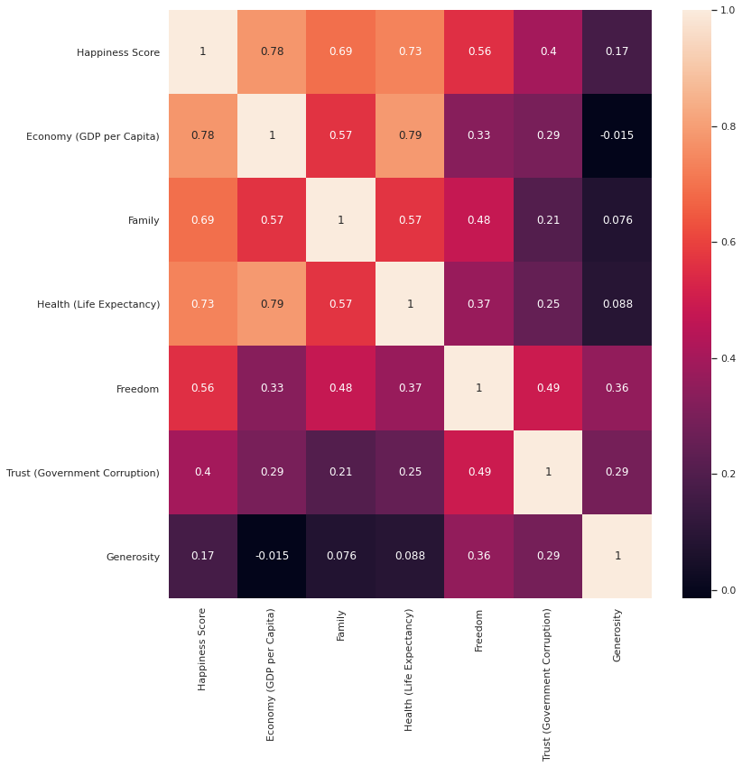
Exploratory Data Analysis
Notes:
Rows that did not have values for these columns were counted as missing
Taking the percentage of missing values vs total number of records gave a baseline understanding of what would most likely not add much insight into our analysis
Explain percentages and dropped columns…

Slide 8
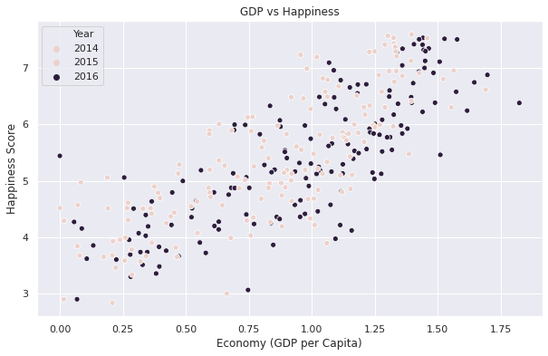
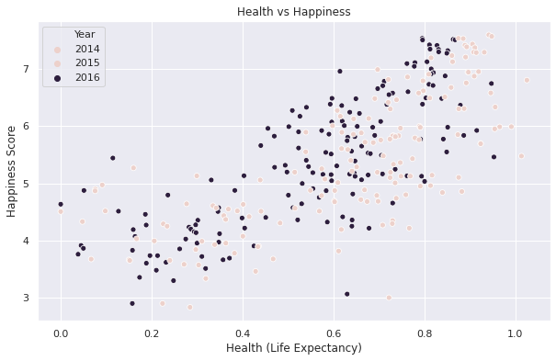
Exploratory Data Analysis

Slide 9
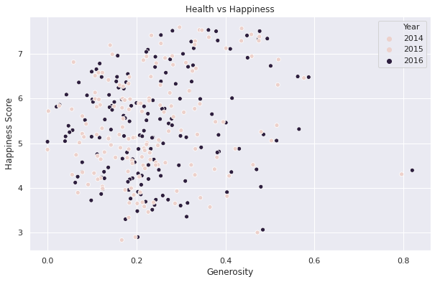
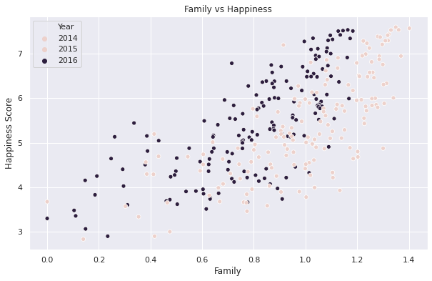
Exploratory Data Analysis

Slide 10
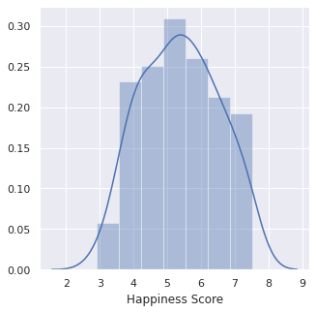
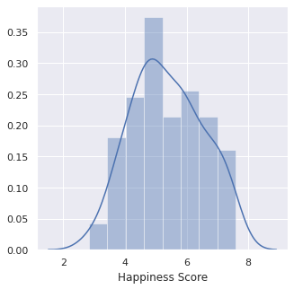
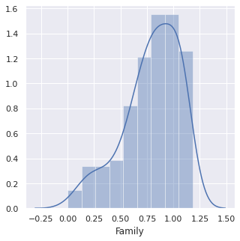
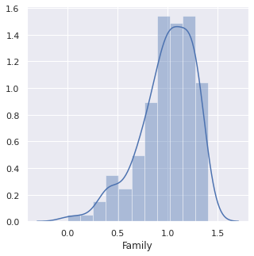
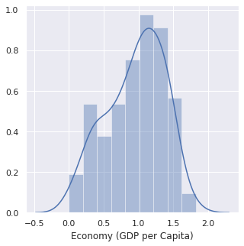
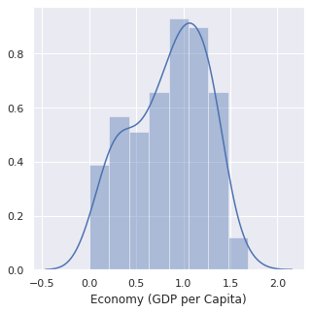
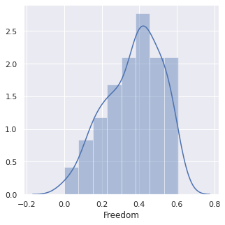
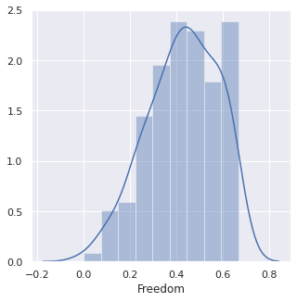
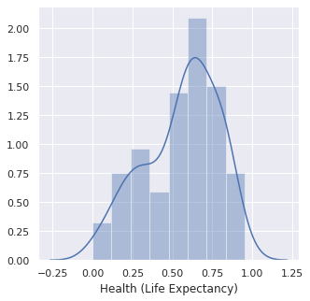
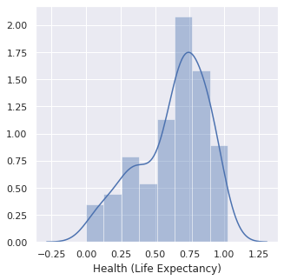
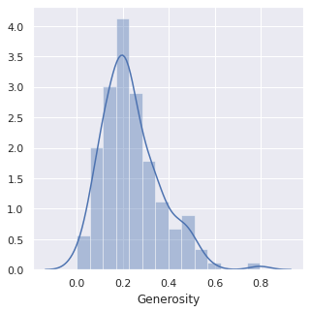
2015
2016
2015
2016
Notes:
One thing to notice is the change slight change in distributions of things like Happiness Score, Family score, and Freedom Score from 2-15 to 2016

Slide 11
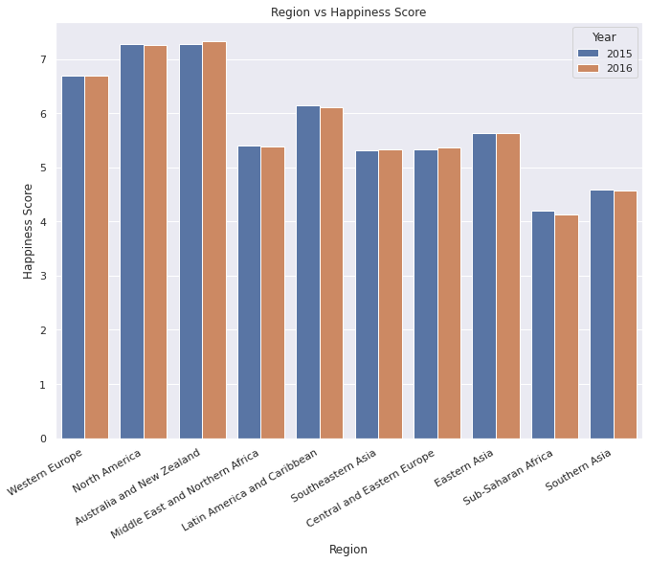
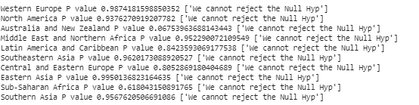
Statistical Analysis

Slide 12
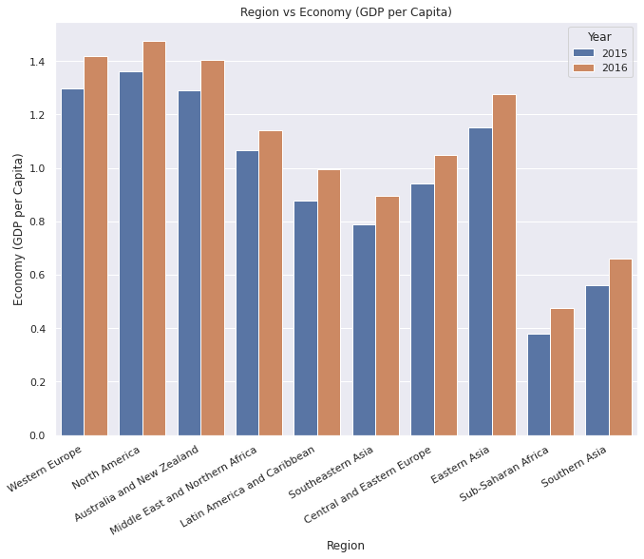
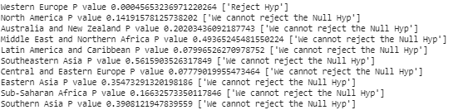
Statistical Analysis

Slide 13
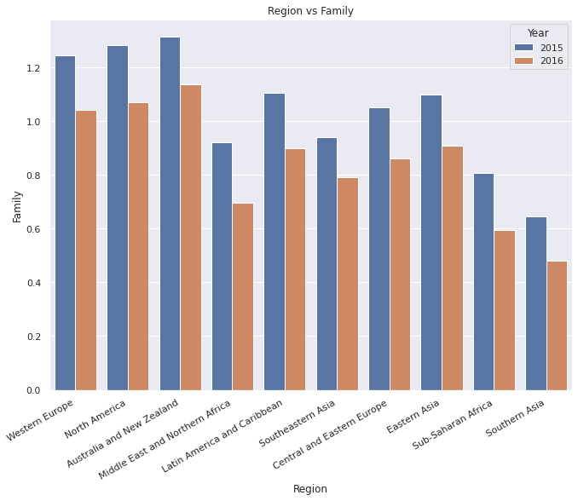
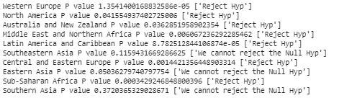
Statistical Analysis

Slide 14
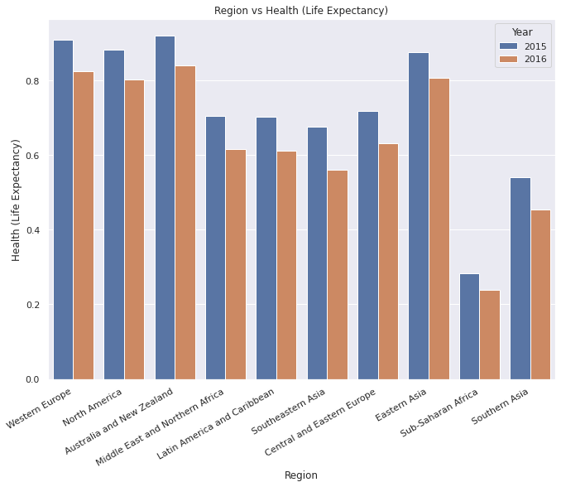
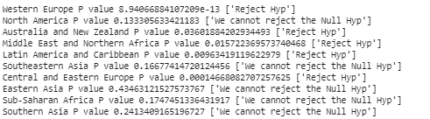
Statistical Analysis

Slide 15
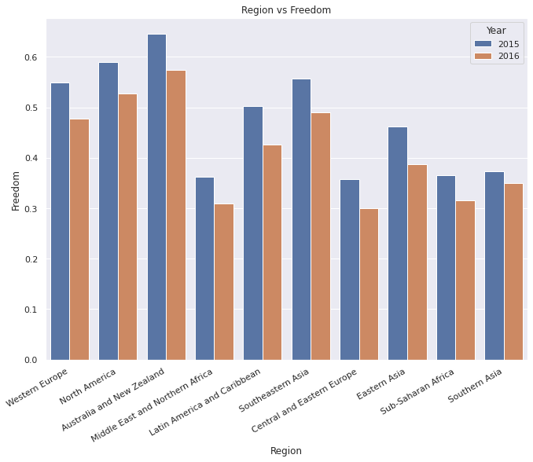
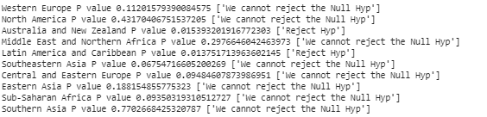
Statistical Analysis

Slide 16
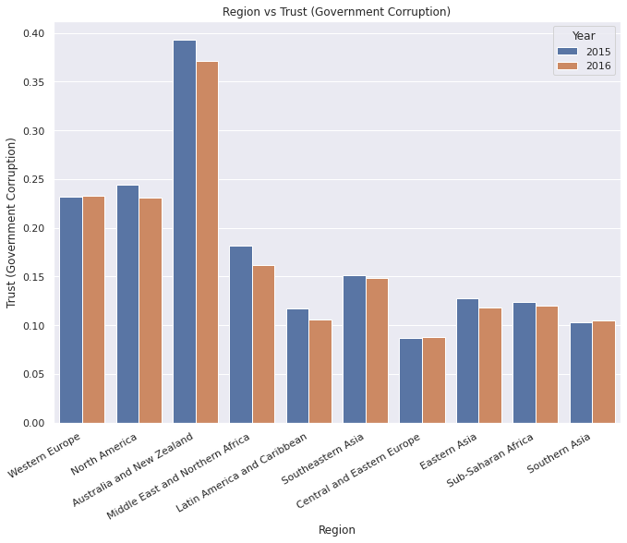
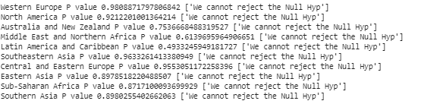
Statistical Analysis

Slide 17
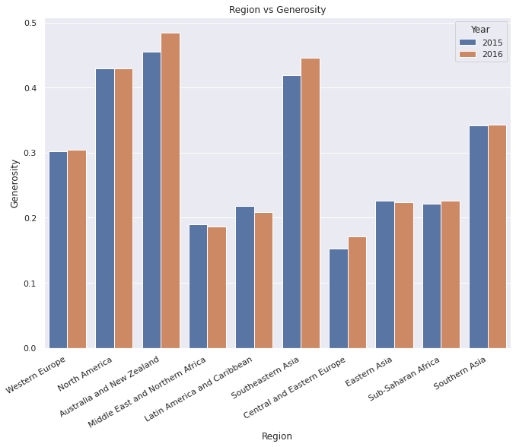
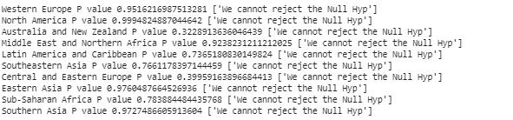
Statistical Analysis

Slide 18
Conclusion
There was no real statistical difference in happiness score from 2015-2016 for each region.
Family rating and life expectancy were the two categories that saw the most regions with a statistical difference.
Was that due to the political landscape in many places?
GDP for each region seemed to have raised overall
GDP, family rating, and life expectancy were the most correlated to Happiness score.
Notes:
One could further dive into working on improving family relationships, keeping gpd up a healthy population would increase the happiness rating of the overall population

